Slide 1

PACKAGE TRACKING SYSTEM
Submitted By ,
GROUP 3

Slide 2
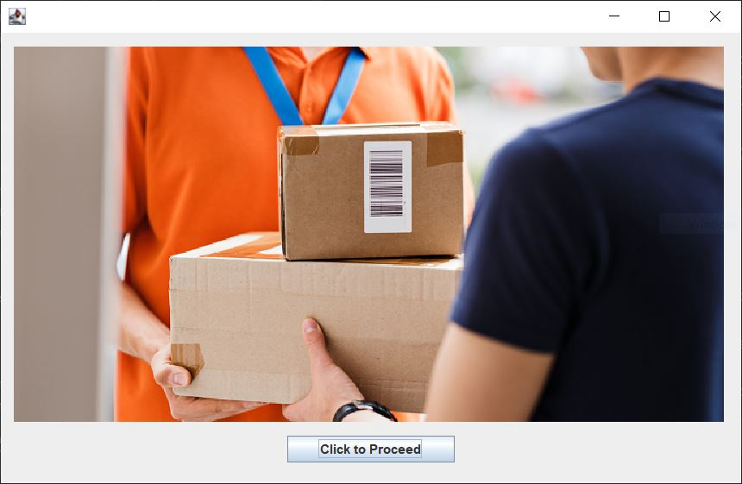
Working
1
Welcome Page

Slide 3
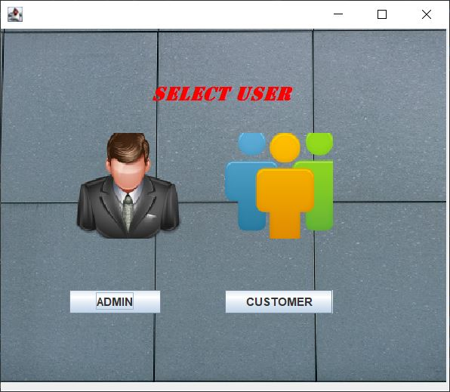
Working
2
User Selection Page

Slide 4
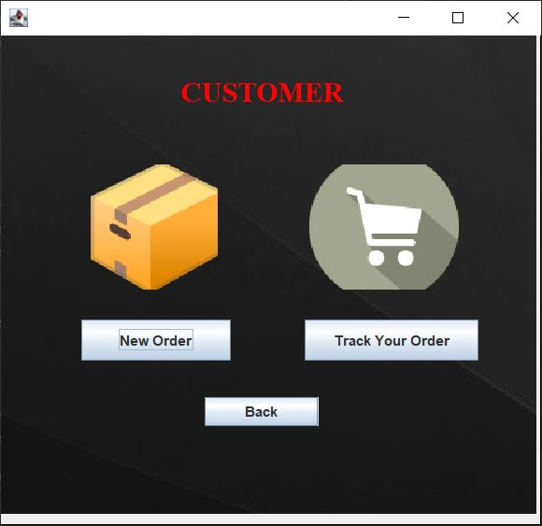
Working
3
Customer Home Page

Slide 5
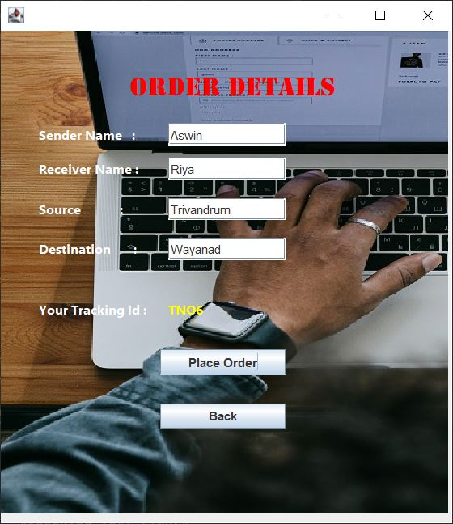
Working
4
Placing Order
On successful placing an order , tracking id is generated automatically

Slide 6
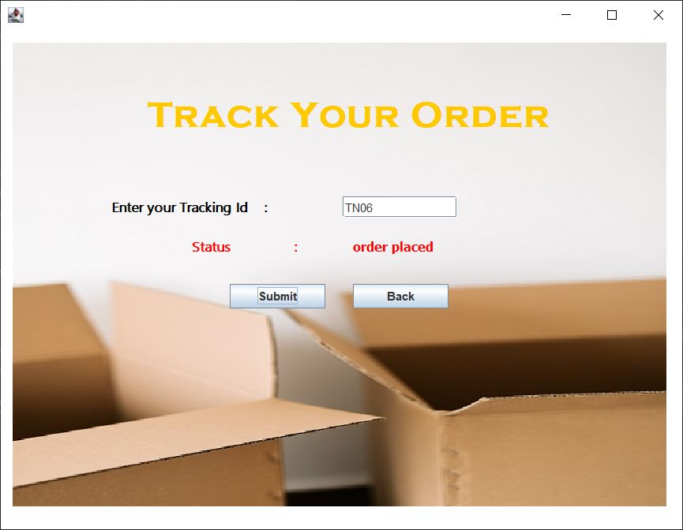
Working
5
Tracking order

Slide 7
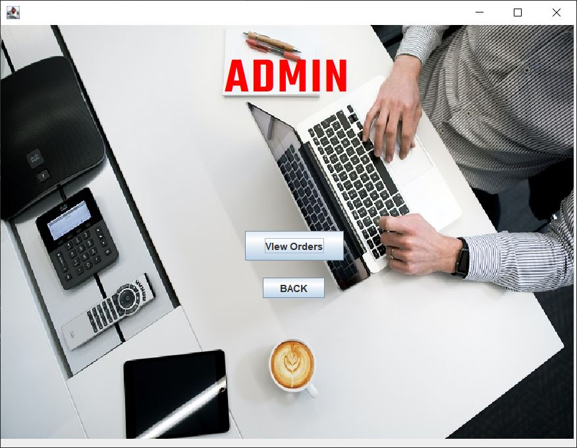
Working
6
Admin Home Page

Slide 8
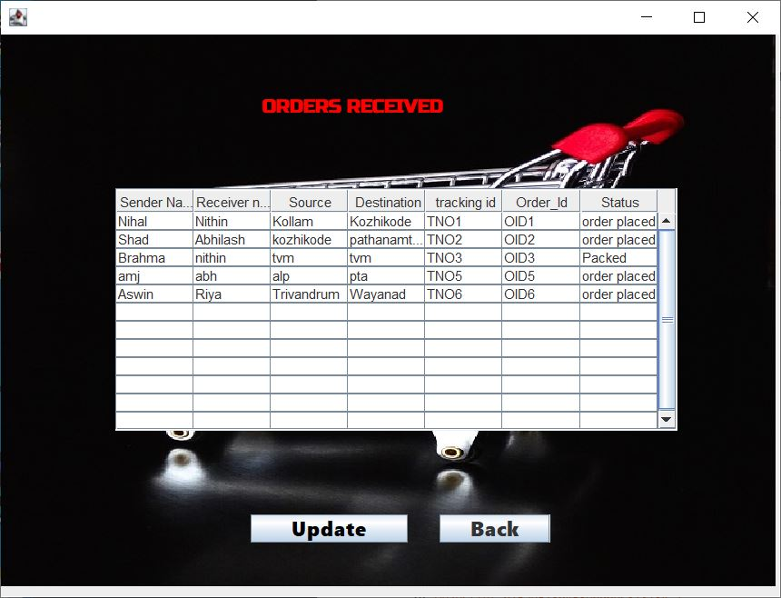
Working
7
View Orders

Slide 9
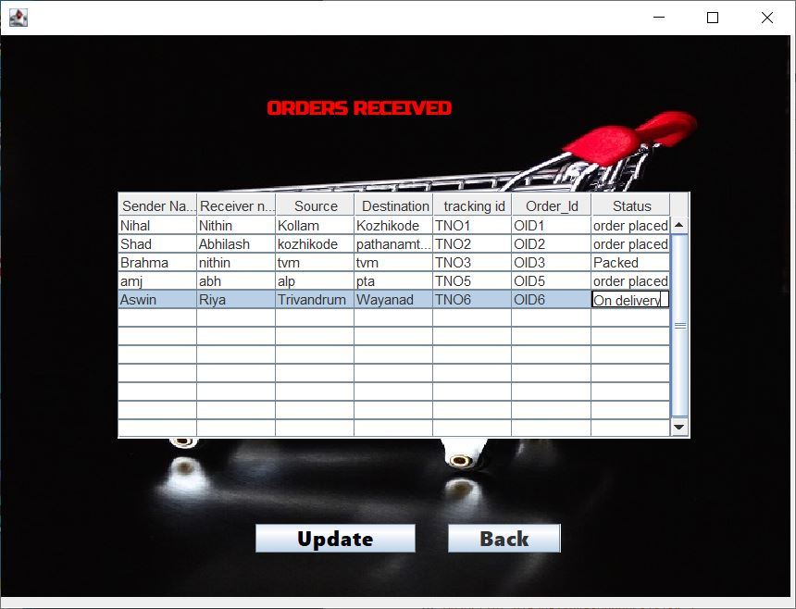
Working
8
Updating Order Status

Slide 10

Working
9
Change in Order Status

Slide 11
THANK YOU

